Slide 1


Management-Led Teaching Observation Training
Susan Bray and Tamar MacLellan
Academic Developers: Professional Recognition and Developing our Teaching

Slide 2
Teaching Observation Scheme ​
Associate Heads of School (Student Experience) or Heads of Curriculum (CU Group) are responsible for the scheme and nominating staff; monitor and report to Office of Teaching and L​earning (OTL) and share with their teams
All staff carrying out observations must be professionally recognised by Advance HE as at least a Fellow but preferably Senior Fellow and be of ‘Appropriate Seniority’​​
All staff carrying out observations must have attended one of the Management Led Teaching Observation webinars or workshops.
50% of teaching staff to be observed each year for Management Led 100% for Apprenticeship.

Slide 3
Teaching Observation Scheme ​
Observations must be of a ‘teaching interaction’ consisting of more than 5 people
This teaching activity may be either asynchronous, synchronous or Face to Face.
Session may be selected​ by AHOS (Student Experience) Head of Curriculum CU Group
Be aware that more than two in the satisfactory category will result in failure of the observed to obtain professional recognition​ with the Advance HE via CUFPA.
AHOS(SE)/ H of C to receive forms to identify development needs and actions​
Opportunities for support from AEPD

Slide 4
Teacher Observers
Peer observation supported (different to Management Led TOB - can be innovative and not classroom based)
Make up other 50% of staff observations.
Peer observation is there to complement the Man Led and Apprenticeship Teaching Observation.
Apprenticeship observation (different to Management Led TOB)
Gold TEF – value of teaching observations.
AEPD Website and Teaching Observation Forms

Slide 5
START
Part 1
Pre-Observation
Part 2
Observation
Actions and Impact
Part 4
Administration
Part 3
Professional Dialogue
END

Slide 6

Activity
What would you discuss when delivering feedback in the following scenarios?
1) Predominantly Excellent practice
2) Predominantly Satisfactory practice
Consider how you would create an environment where both individuals can develop
Notes:
At end have discussion on what they have come up with
Exercise 15 mins to do and 15 to discuss
Consider:
The lecturer delivering
The students learning
The environment

Slide 7

What gets in the way?

Slide 8

What could prevent your feedback from being received?
Lack of trust
Low rapport
Staff member does not feel listened to
Lack of clarity
Lack of facts and examples
The reviewer has put forward their own solutions only
Notes:
Exercise – brainstorm in groups before showing list. How can we address each issue?

Slide 9

How can a coaching approach support the teaching observation scheme?
Offers an individual focus
Value afforded to own context and practice
Shift from directive to supportive
Increases autonomy
O’Leary, M. (2020). Classroom Observation – A Guide to the Effective Observation of Teaching and Learning. Routledge

Slide 10
What is coaching? ​
Coaching focusses on future possibilities, not past mistakes
Coaching is unlocking a person’s potential to maximise their own performance
It is helping others to learn rather than teaching them
Coaching is a joint endeavour that moves beyond known practice to energise change
Whitmore, W. (2017). Coaching for Performance: Principals and practice of coaching and leadership. Nicolas Brealey Publishing
Norman, C. (2022). The Transformational Coach: Free your thinking and breakthrough to coaching mastery. Right Book Press

Slide 11
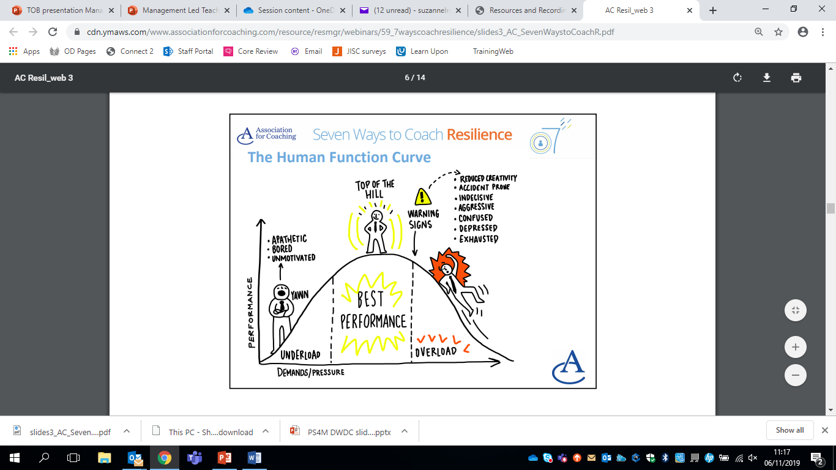
START
Awareness
Understanding
Open Minded
The Human Function Curve

Slide 12
Part 1
Pre-Observation
The art of listening with palpable respect and fascination… determines the quality of other people’s thinking
Kline, N. (1999). Time to Think – Listening to Ignite the Human Mind. Cassell Illustrated, London
Notes:
Staying with the work of Nancy Kline for a moment, from her work Time to Think,
Kline is of the opinion that it is so vital that we think and listen well in order to generate the finest thinking in others, because this informs our actions. What Nancy Kline calls generative attention – to encourage other person think better for themselves.
It is much more than listening for content for information, fundamentally more humanising impact.
Multiple intelligences, mind and body, head, heart and gut.

Slide 13
Part 2
Observation
Action
What actually happened?
What did you observe?
Impact
What impact did the action have on you, others, other stakeholders, project or environment?
Desired Behaviour
What could be done
differently next time?
What behaviour change is expected?
Landsberg, M. (2015). The Tao of Coaching. Profile Books

Slide 14
Re-Read
Observation Focus
Field Notes
PAUSE
Questions?
Ideas?
Identify Strengths
Possible Development
Suggestions for Next Steps

Slide 15

Part 3
Professional Dialogue
Listening
Feedback
Powerful questions
Assist the staff member to explore issues arising from the staff member’s definition of the teaching focus/issue to be explored;​
Help the staff member reflect critically on those issues;​
Find ways in which the staff members can move forward constructively to further explore and find answers to the questions identified.​
Review of Professional Practice (RPP)

Slide 16
Co-Constructing Actions
Which areas are going to be most important for you to focus on?
What are your options? Which option would give you the best result?
Who else might you involve to support you?
What might get in the way of you moving forward?
How will you address that (barrier)?
What will you do first (to address an area for improvement)?

Slide 17
Next Steps
Teaching Observation Scheme: Information, Forms and Resources
If you have any questions, or would like further support, please get in touch:
Susan Bray: ac0104@coventry.ac.uk
Tamar MacLellan: ad5070@coventry.ac.uk

