Slide 1

Leveraging AI to redevelop teaching content for new audiences.
Making better use of the CUOnline archive

Slide 2
The Challenge
The Phoenix plus online program required resources to support students in developing a variety of soft skills

Slide 3
The initial fix
Share a small subset of resources from the archive
Copy into the new platform
Transcribe some passages into AI generated video
Add activities linked to the previous context

Slide 4
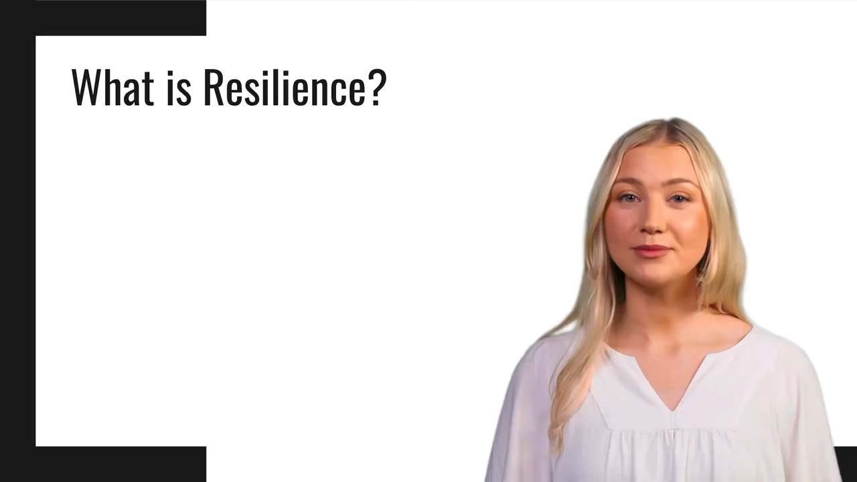
The result
Unengaging
Out of context
Too academic

Slide 5
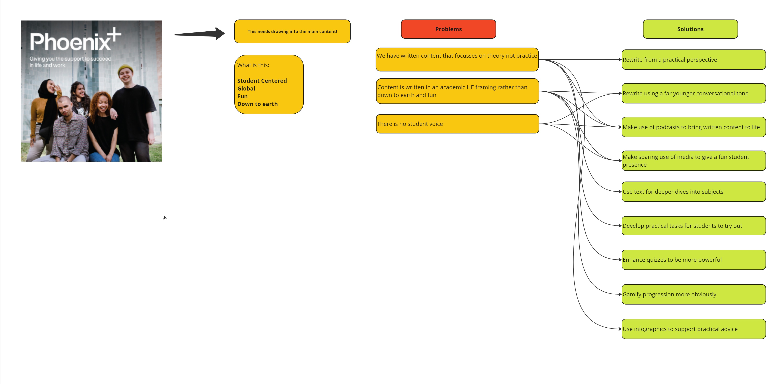
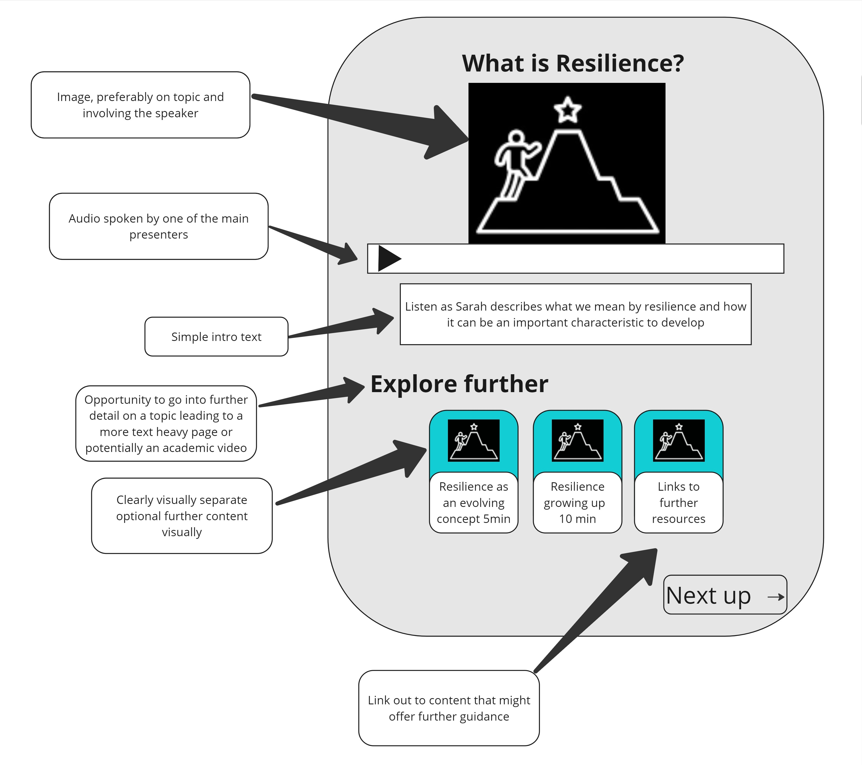
A Second Treatment

Slide 6
The (usual) Problem
Very limited resource to make new content
Tight timelines to deliver in

Slide 7

The solution

Slide 8
The process
Meet to agree required theme details
Collate content and organize into three topics
Use AI to create a podcast
Work with AI to develop suitable activities
Work with AI to develop suitable engagement videos
Search the archive using likely keywords
Use AI to create articles on each topic from source materials
Human records podcast
Editor reviews and humanizes content

Slide 9
The prompts
You are an editor for a magazine aimed at young
adults in higher education who are preparing for life
as graduates. You have been asked to write a 2000 word
article on the topic of ’Add Topic’.
To support you with this you have been given content that
you should use as the basis for the article which is included in the attached file.
Create an article on ‘Add Topic’ that is written in a mature style that aims to give the reader ‘Add specific areas of focus’.
It may mention certain authors when required but doesn't include formal citation and referencing
Add If necessary – ‘Include information not specifically found in the source material if relevant, required and accurate.’
Hi, could you take the following notes and turn them into a script for a 5-minute podcast that aims to remind new graduates about ‘Add Topic’. It should be conversational in tone as if delivered by a peer and be ordered so as to cover the basics of what is included in the attached file. It should aim to not go into too much detail but should act as a summary that listeners can use to get a grip of the basics.

Slide 10

The output
More engaging
Less high brow
Introduces the major points
Invites further interest

