Slide 1
Curriculum & Course Design for Contemporary Higher Education
Designing courses for 2016 and beyond...
Martin Jenkins & Susan Bray
December 2016
Notes:
“At the present time more attention is probably being given to course design in higher education that at any time since the beginning of the century”
Toohey, 1999

Slide 2
Introduction
Curriculum and course
Outcomes based approaches
  Quality and standards
Course design
  Constructive alignment, signature pedagogies, threshold concepts
  Graduate attributes, equality of attainment, research-inspired teaching, Technology-enhanced learning, employability, intercultural and international engagement, creativity and enterprise … (Dec/April)
Evaluation/research
Integrated Assessment (April)

Slide 3
Overview
Curriculum & Course Design
  Influences and challenges (strategic)
  Theory and frameworks to support your decision-making (operationalising)
  Relate to your own practice
    RUNNING ACTIVITY
    Acting as an advisor/consultant and taking a course based approach to curriculum design, advise colleagues in your school or department on key ideas that they need to consider in the design of a new course in the subject area of your choice.
    For this activity you will work in groups but will be expected to build your own toolkit for future reference or to use the information to advise others.
    This activity will run across both the December and April face-to-face sessions.

Slide 4
What do we mean by a course?
What do we mean by a curriculum?

Slide 5
Curriculum
Overall content of what is to be taught
  as in the "National Curriculum"
The underlying principles of the approach to teaching and learning
  as in a "developmental curriculum" or a "competency-based" curriculum.
It can embrace both elements, and refer to the overall "what", "how" and "why" of teaching
  Note that on the whole it is a "teaching side" — rather than "learning side" — term.

Slide 6
Barnett & Coate (2004) Curriculum Schema
Knowing
  Act of knowing, claiming ownership, engaging
Acting
  Practice, skills
Being
  Developing self, capability, self-realisation
Knowing
Acting
Being

Slide 7
Barnett & Coate (2004) Curriculum Schema
Draw your representation of the curriculum in your discipline area
Knowing
  Act of knowing, claiming ownership, engaging
Acting
  Practice, skills
Being
  Developing self, capability, self-realisation
Knowing
Acting
Being

Slide 8
Arts & Humanities
Knowing
Sciences
Being
Acting
Knowing
Acting
Being
Knowing
Acting
Being
Professional

Slide 9
Process vs Product
Curricula as:
  The structure and content of a unit
  The structure and content of a programme of study
  The students’ experience of learning
  A dynamic and interactive process of teaching and learning
  A&B = product; C&D = process
  (Fraser & Bosanquet, 2006)
  (see also Lahiff, 2006 – Curricula debates in Higher Education – an overview)

Slide 10
Outcomes based approaches
Principles:
All learning expressed as intended learning outcomes
  Clearly articulate learning
Units of learning described in terms of learning outcomes and assessment criteria
Levels of learning
Reference to quality standards
(see Lahiff, 2006 – Curricula debates in Higher Education – an overview)

Slide 11
Quality assurance
  the process for checking that the academic standards and quality of higher education provision meet agreed expectations.
Threshold academic standards
  the minimum acceptable level of achievement that a student has to demonstrate to be eligible for the award of academic credit or a qualification. For equivalent qualifications, the threshold level of achievement is agreed across the UK.
Academic standards
  the standards that individual degree-awarding bodies set and maintain for the award of their academic credit or qualifications. These may exceed the threshold academic standards. They include the standards of performance for a particular classification of a qualification,.
Academic quality
  learning, teaching and assessment, and all the different resources and processes a provider puts in place to help students progress and fulfil their potential.
QAA, 2015

Slide 12

A QAA Perspective
The UK Quality Code for Higher Education is the nationally agreed, definitive point of reference for all those who deliver or support UK higher education programmes.
safeguarding academic standards
assuring the academic quality of learning opportunities
promoting continuous and systematic improvement (enhancement)
ensuring that information about programmes is fit for purpose, accessible and trustworthy.
Benchmark Statements
http://www.qaa.ac.uk/en/Publications/Documents/Quality-Code-Overview-2015.pdf
Notes:
Effective teaching and support for learning occurs when staff display a sound
understanding and up-to-date knowledge of their subject and/or professional practice
and they bring this to a variety of appropriately designed learning and teaching
activities and assessment methods. They communicate enthusiasm, and draw on
scholarship, research and professional activity to facilitate student learning. Staff
create opportunities for learning which are effective by recognising the value of both
individual and collaborative learning activities, the value of learning how to learn, and
that learning is about interpretation, analysis and synthesis underpinned by reflection,
not just the repetition of facts.

Slide 13
Levels and Learning Outcomes
What distinguishes a Masters Learning Outcome from Level 1 Outcome?
National qualifications framework determines the outcomes of each qualification level:
  From level 1 to Doctoral Level

Slide 14
Framework for Higher Education Qualifications (FHEQ)
The framework for higher education courses. It starts at level 4 and goes up to level 8.
Qualifications it covers include:
  Certificate of Higher Education
  Diploma of Higher Education
  Bachelor’s degrees
  Master’s degrees
  Doctoral degrees

Slide 15
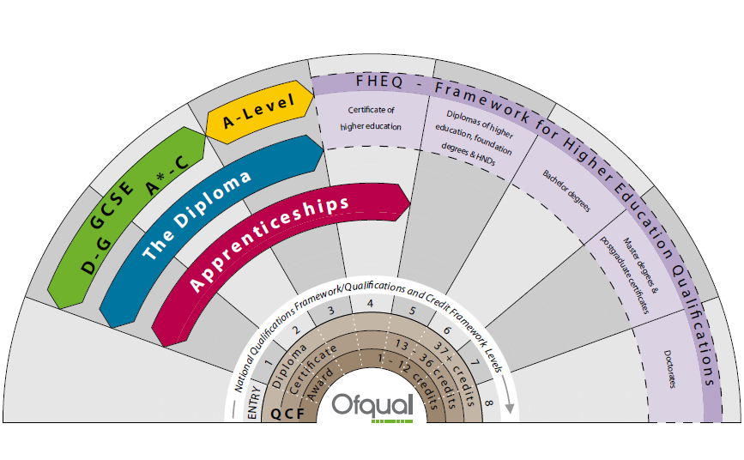
Comparing Qualification Frameworks and Levels
Source: http://www.ofqual.gov.uk/help-and-advice/comparing-qualifications/
Notes:
There are 4 main frameworks that group all qualifications into the same levels from entry to level 8.
The frameworks in England, Wales and Northern Ireland are:
National Qualifications Framework (NQF)
Qualifications and Credit Framework (QCF) in England and Northern Ireland
Credit and Qualiﬁcations Framework for Wales (CQFW) in Wales
Framework for Higher Education Qualifications (FHEQ)
All qualifications in these frameworks are accredited (officially recognised).

Slide 16
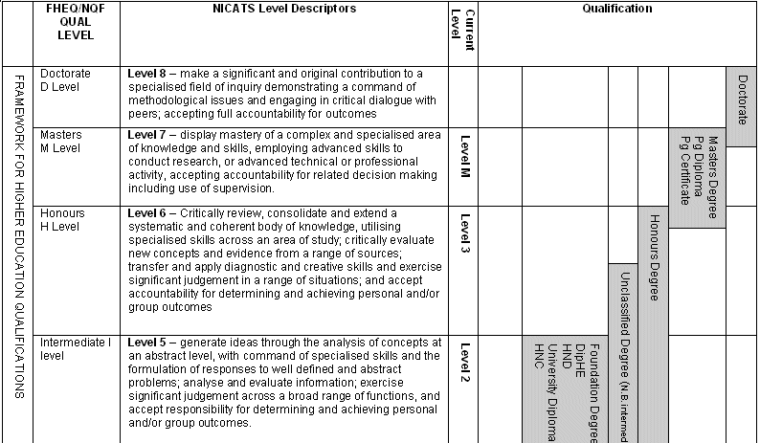
Relationships between Qualifications:
Coventry University Framework
Notes:
NICATS stands for Northern Ireland credit accumulation and transfer scheme fill this in.
This illustrates where master’s level fits in with the scheme of things. Under the university regulations there can be some u/g element in a masters programme.

Slide 17
Credit Level Descriptors
Credit level descriptors are essentially aids to programme development, describing broad outcomes
  NICATS
  SEEC
Qualification descriptors are aids to the quality assurance of programmes
  Framework for Higher Education Qualifications

Slide 18
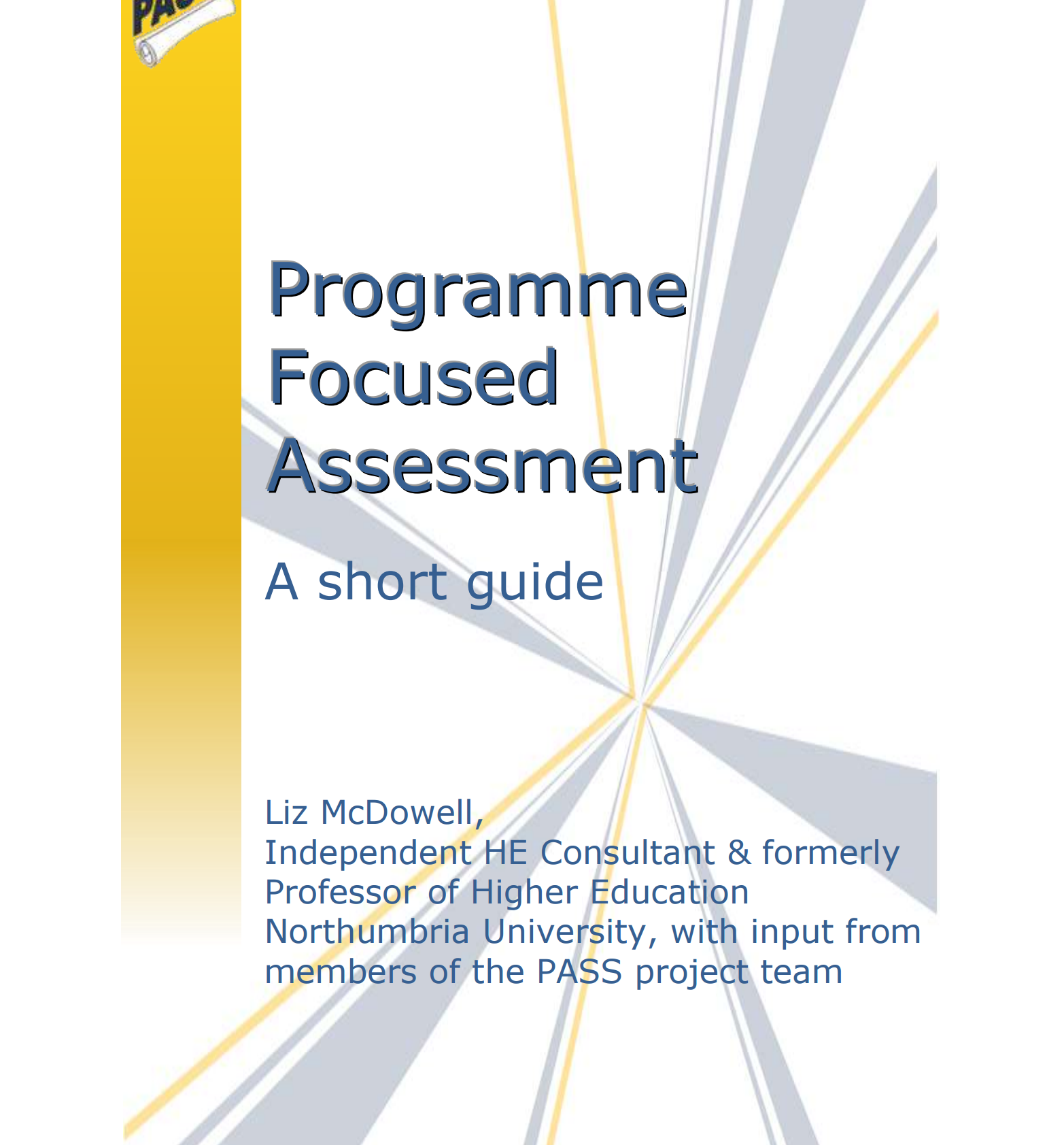
Why course-based?
http://www.pass.brad.ac.uk/short-guide.pdf
Review Section 3 in your groups

Slide 19
Why course-based?
Coherence
Consistency
Developmental pathways; ‘slow learning’
Assessment load
  (see McDowell, 2012)
We will maintain flexibility in teaching methods, however, new approaches to assessment and support will ensure that the university strengthens the course-based approach and is a global leader in higher education. (Education Strategy, p16)
The university is committed to a course-based approach across all aspects of student education … Ownership and accountability for assessment is firmly placed within course teams (Assessment Strategy, p2)

Slide 20
Influences on Course Design - Discussion
What are key influences on course design?
Discuss in tables and add to flip chart
Notes:
Collect and divide into internal and external influences....
HEFCE restrictions on growth student numbers
Need to ‘optimise course design’
Enhancing the learning experience but maintaining research profile/activity
Internationalisation
Meeting the needs of an increasingly diverse student population
New QAA quality criteria for courses

Slide 21
Some influences on course design
Institutional strategic aims
Education & Assessment strategy
competition
Student expectations
Employment and employers
League tables
Academic practice
Government expectations
Course Design
Notes:
Cu corporate plan elements:
Cap on student recruitment – retention increasingly important but also addressing the anticipated growth in overseas students. Anticipated growth to 2144 ftes by 2009/11
Achieve 80% graduate level employability (around 64% currently)
Achieve student satisfaction rating of 90%
Increasing placements to 4000 a year – radical change to the model.
Campus development – smart campus, move to moodle, repository, web2.0 technologies
Students living at home, part time work, students whose language is not English
Personalised learning environments.
Opportunities to use the NSS student data and own insitutional satisfaction data – can use to inform staff rewards.
Changing nature of academic practice – delivery in Applied research, business facing, employability, student expectations, staff-student ratios
Ramsden talks of innovative and flexible curricula – part-time, work-based learning, flexible routes

Slide 22
Key influences on teachers' design decisions.
(Bennett et al, 2014)
Focus | Description
Student related | Teachers perceptions of the students in this unit (anticipated cohort, influenced by previous experience of the types of students who enrol in this unit)
 | What students are to learn in this unit within the context of the program and profession/discipline
 | Student feedback and responses during the teaching session (e.g., engagement in class/online, performance on assessment tasks, feedback and evaluations)
Teacher related | Beliefs about teaching and learning, influenced by theory, professional learning, others' ideas from literature or collegial discussion
 | Own prior experience of teaching in this and other contexts
 | Beliefs about themselves as a teacher (e.g., an innovator)
Context related | Colleagues (within institution, within discipline)
 | Industry/professional accreditation
 | Institutional requirements (policy and culture)
 | Attributes of the unit (official description, class size, timetable)
 | Resources (e.g. staff, workload, time, infrastructure)

Slide 23
The learner?
Changes in the School curriculum – skills and subjects
Diverse, International, Global
Discerning / Consumers? / Vocationally orientated
Networked - connected
Have never known non-digital culture
Prefer graphics before text
Thrive on instant gratification
‘prefer games to work’
Notes:
the generation of networked learners variously named the children of chaos, digital natives or MTV generation who have never know non-digital culture expect instaneity from cash machines, the web and multichannel TV and thrive on the democratic condition. Digital natives are used to reeiveing information really fast. They like to parallel process and multi-task. They prefer graphics before their tet rather than the oppposite. They prefer random access. They function best when networked. They thrive on instant gratification and frequent rewards. They prefer games to serious work
Diverse: undergraduates – global, in different places.

Slide 24
Operationalising
Theories, Frameworks, Principles
  Constructive alignment
  Threshold concepts
  Learning design models
    Backward design
    Seven principles of good practice
    AUTC Learning Designs
  Graduate attributes
  Research-inspired Teaching
  Embedded employability
  Technology-enhanced learning/digital fluency
  Intercultural and international engagement
  Creativity and enterprise

Slide 25

Constructive alignment
The key principle in learning and course design:
“Good design for learning seeks to ensure that there are no inconsistencies between the learning objectives, the chosen activities and how learners are assessed”
(Biggs 1999)

Slide 26
Constructive alignment
The operational framework for this teaching design:
Describe the intended learning outcomes (ILOs) for the unit, using one verb (or at most two) for each outcome. The ILO denotes how the content or topics are to be dealt with and in what context.
Create a learning environment using teaching/learning activities (TLAs) that require students to engage each verb. In this way the activity nominated in the ILO is activated.
Use assessment tasks (ATs) that also contain that verb, thus enabling one with help of predetermined using rubrics to judge how well students’ performances meet the criteria.
Transform these judgments into final grades.
(Biggs, 2014: p8)

Slide 27
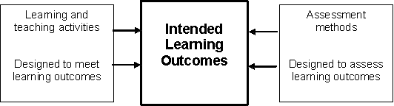
Learning outcomes describe what a student should be able to do at the end of a period of learning
http://exchange.ac.uk/learning-and-teaching-theory-guide/constructive-alignment.html
Notes:
Learning outcomes and programme specifications were introduced by the QAA in the late 1990s in response to the dearing report. Up until that time, courses were ill-defined, largely designed in response to the research interests of staff and opaque in terms of what they delivered for students.

Slide 28
Introducing threshold concepts …
A different way of thinking about course design

Slide 29
Threshold concepts
A threshold concept can be considered as akin to a portal, opening up a new and previously inaccessible way of thinking about something. It represents a transformed way of understanding, or interpreting, or viewing something without which the learner cannot progress. As a consequence of comprehending a threshold concept there may thus be a transformed internal view of subject matter, subject landscape, or even world view. This transformation may be sudden or it may be protracted over a considerable period of time, with the transition to understanding proving troublesome. Such a transformed view or landscape may represent how people ‘think’ in a particular discipline, or how they perceive, apprehend, or experience particular phenomena within that discipline (or more generally).
Meyer & Land, 2003

Slide 30




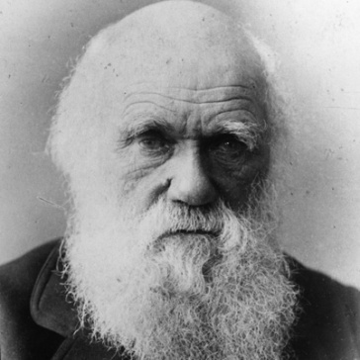
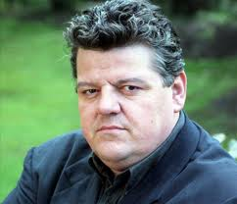

The student journey........
Notes:
From student to graduate professional – when you design a course you are designing a student journey...
ong and winding road – is the direction less certain. Do you know your destination and where you are going.
Is it all uphill?
Meandering
Are there any landmarks
Signposting – guides travellers

Slide 31
Journey from student to professional
Threshold knowledge
To Graduate
professional
From student
Skills
Skills
Skills
Language and discourse
Knowledge
Capabilities
Notes:
How do we recognise these changes in students.....
What supports the student identity – professional practice is a key
Learning within a community of practice transforms who a student is and what a student can do – not just an accumulation of skills and information but also a process of becoming.
The practices of a community create a context for learning, and learning opportunities unfold through engagement in practice, in other words participation

Slide 32
Threshold Characteristics
Transformative
  they shift a learner’s perceptions of a subject
Irreversible
  once learned, they are hard to unlearn
Integrative
  they expose the inter-relatedness of some things
Troublesome
  they appear difficult and unintuitive
Notes:
Also discuss bounded and troublesome
Grasping a threshold concept is transformative
A threshold concept is often irreversible
Integrative – allows a learner to make connections
Transformative because is involves an ontological as well as a conceptual shift – ontological - nature of being – you are what you know
Once understood they are not forgotton – could be the rejection of a previously held belief
Also involve a shift in subjectivity and extended use of discourse
Involve forms of ‘troublesome’ knowledge - can be counter-intuitive.

Slide 33
Threshold concepts
Addresses the concern to teachers of why certain students ‘get stuck’ at particular points in the curriculum whilst others grasp concepts with comparative ease.
Threshold concepts = Troublesome knowledge
Notes:
Threshold concepts are those ideas central to the discipline, that open up required systems and ways of thinking and yet are troublesome for students

Slide 34

Threshold concepts can be considered akin to a portal or gateway
Notes:
Difficulty in understanding a threshold concept may leave a learner in a liminal space or a state of liminality.
As a consequence of comprehending a threshold concept there may thus be a transformed internal view of subject matter, subject landscape, or even world view.
Meyer and land suggest that learning involves the occupation of a liminial space – betwxt and between – notion of oscillating.
Need to talk about mimicry

Slide 35

Activity: Identifying threshold concepts
What are the sticking points / key difficulties (threshold concepts) that students face in your discipline.
Why are these areas difficult for students to grasp?
How do you know that the students have acquired the threshold – how have they changed?
Share in groups: are their any common characteristics
Notes:
Allow 15mins discussion
What strategies can we use to help students ‘move through’ that particular sticking point / difficulty (threshold)? How can we support students to acquire that particular skill or attitude?
Changes – e.g. Discourse, language, empathy...

Slide 36
Some examples
Economics – ‘opportunity cost, price, elasticity’
Transport design – ‘spatiality’, confidence to challenge
Mathematics – ‘complex numbers’
Law - ‘precedence’
Biology, Psychology - ‘evolution’
Politics – ‘the state, civil society’
Medical studies – ‘pain’
Notes:
Pure Maths – ‘complex number, a limit’
Literary studies – ‘signification, deconstruction’
Economics – ‘opportunity cost, price, elasticity’
Design – ‘design’
Sports Science – ‘aquatic confidence’
Exercise Physiology – ‘metabolism’
Law - ‘precedence’
Accounting - ‘depreciation’
Biology, Psychology - ‘evolution’
Politics – ‘the state, civil society’
Medical studies – ‘pain’

Slide 37

Implications for teaching
Identification of the thresholds within a subject: staff and student perspectives.
Creating learning activities designed to “scaffold” or support students to acquire concepts.
Whilst students may have feeling of exhilaration brought about by acquiring a concept, they might equality experience a sense of loss or stress.
Understanding students’ ‘pre-threshold’ perspective
Notes:
e.g. media studies students seeing the world as being trustworthy to having a deep mistrust of headlines
Some of the stress of learning could be.

Slide 38
Implications for the Curriculum
Jewels in the curriculum – focus on the jewels
Engagement is important
Listening for understanding in order to engage with students
Attention has to be paid to the ‘discomforts’ of troublesome knowledge
Teachers need to provide an environment for the ‘toleration of uncertainty’
Provide a means for benchmarking curricula
May be more easier to identify in some subjects (STEM) than others (Humanities)
Notes:
Threshold concepts can be used to define potentially powerful transformative points in the student’s learning experience. They are the ‘jewels in the curriculum’ because they identify key areas that need mastery. [from Cousin, 2006]
Existing literature regarding teachers who want students to develop genuine understanding of a difficult concept points to the need for engagement eg. They must ask students to
explain it
represent it in new ways
apply it in new situations
connect it to their lives
and NOT simply recall the concept in the form in which it was presented (Colby, et.al, 2003: p263)
Can also talk about recursiveness.
Listen for understanding – idea of the third ear. Listen not for what the student knows but for terms that shape a students knowledge.

Slide 39
Conclusions
The shift in the HE landscape has led to a renewed focus on the importance of course design.
Threshold concepts provide an approach that enables teachers to focus on what is fundamental to a grasp of a subject.
If learning is at time uncomfortable and challenging – how do we square this with short term satisfaction?
Notes:
Where are you adding value
Identity:
How and where do I add value to the students learning
Content knowledge
Managing the learning process

Slide 40
If students are to learn desired outcomes in a reasonably effective manner, then the teacher’s fundamental task is to get students to engage in learning activities that are likely to result in their achieving those outcomes. . . . It is helpful to remember that what the student does is actually more important in determining what is learned than what the teacher does. (Shuell, 1986, p. 429)

Slide 41
Making the links to other workshops
Course Design
Internationalising
the curriculum
Assessment for learning
Enterprise & Employability
Digital literacy / technology
Principles for design
Research-teaching linkages
Evaluation

Slide 42
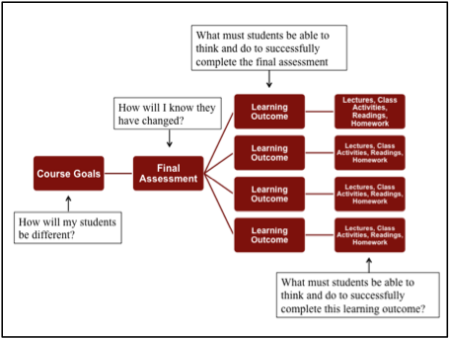

Slide 43
Seven Principles of good practice in course design
Good practice...
Encourages student-faculty feedback
Encourages co-operation among students
Gives prompt feedback
Emphasises time on task
Communicates high expectations
Respects diverse talents and ways of learning
Source: Chickering, A.W. and Gamson, Z. F. from The American Association for Higher Education Bulletin, March 1987
Notes:
1. Good Practice Encourages Student-Faculty Contact
Frequent student-faculty contact in and out of classes is the most important factor in student motivation and
involvement. Faculty concern helps students get through rough times and keep on working. Knowing a few
faculty members well enhances students' intellectual commitment and encourages them to think about their
own values and future plans.
2. Good Practice Encourages Cooperation among Students
Learning is enhanced when it is more like a team effort than a solo race. Good learning, like good work, is
collaborative and social, not competitive and isolated. Working with others often increases involvement in
learning. Sharing one's own ideas and responding to others' reactions improves thinking and deepens
understanding.
3. Good Practice Encourages Active Learning
Learning is not a spectator sport. Students do not learn much just sitting in classes listening to teachers,
memorizing pre-packaged assignments, and spitting out answers. They must talk about what they are
learning, write about it, relate it to past experiences, and apply it to their daily lives. They must make what
they learn part of themselves.
4. Good Practice Gives Prompt Feedback
Knowing what you know and don't know focuses learning. Students need appropriate feedback on
performance to benefit from courses. In getting started, students need help in assessing existing knowledge
and competence.
In classes, students need frequent opportunities to perform and receive suggestions for improvement. At
various points during college, and at the end, students need chances to reflect on what they have learned,
what they still need to know, and how to assess themselves.
5. Good Practice Emphasizes Time on Task
Time plus energy equals learning. There is no substitute for time on task. Learning to use one's time well is
critical for students and professionals alike. Students need help in learning effective
time management. Allocating realistic amounts of time means effective learning for students and effective
teaching for faculty. How an institution defines time expectations for students, faculty, administrators, and
other professional staff can establish the basis for high performance for all.
6. Good Practice Communicates High Expectations
Expect more and you will get it. High Expectations are important for everyone - for the poorly prepared, for
those unwilling to exert themselves, and for the bright and well motivated. Expecting students to perform well becomes a selffulfilling
prophecy when teachers and institutions hold high expectations of themselves and make extra
efforts.
7. Good Practice Respects Diverse Talents and Ways of Learning
There are many roads to learning. People bring different talents and styles of learning to college. Brilliant
students in the seminar room may be all thumbs in the lab or art studio. Students rich in hands-on
experience may not do so well with theory. Students need the opportunity to show their talents and learn in
ways that work for them. Then they can be pushed to learning in new ways that do not come so easily.

Slide 44
Designing instruction for learning
Informing
Engagement
Practice
Summative Assessment
McAlpine, L (2005) Designing learning as well as teaching: a research based model for learning that emphasizes learner practice, Active Learning in Higher Education, 5(2)

Slide 45
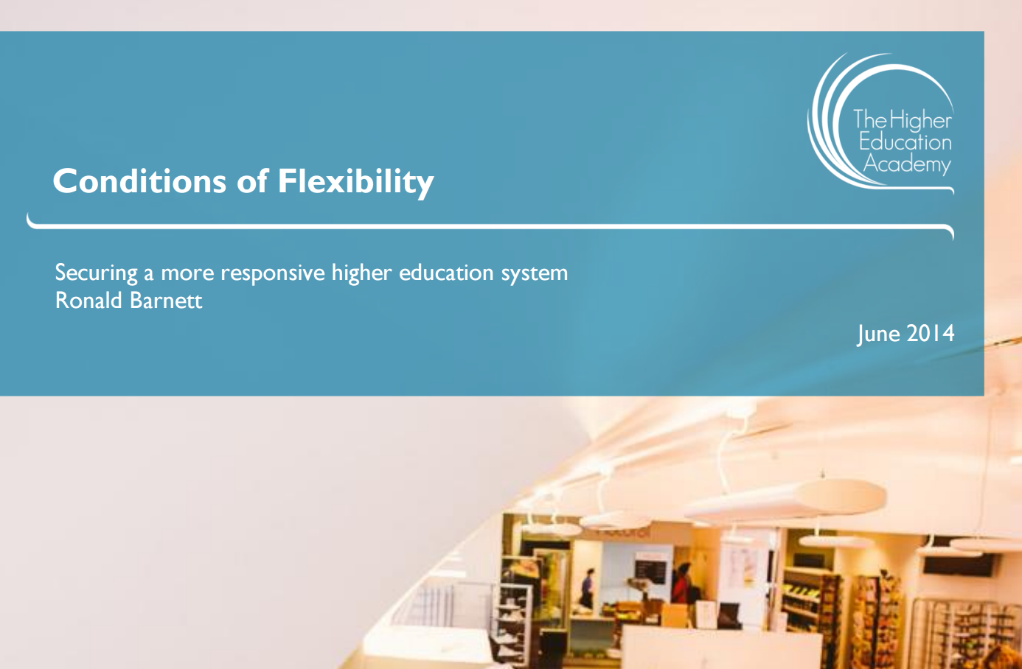

Slide 46
Flexibility
The drive toward greater flexibility is influenced by:
  the marketisation of higher education;
  the emergence of students-as-consumers, exerting wishes for new kinds of educational provision;
  the potential of new digital technologies; and
  the apparent potential (that new educational environments are opening) for widening higher education at reduced unit costs.
  Barnett (2014: 8)

Slide 47
Barnett’s interpretation of flexibility
Sector flexibility:
  enabling flexible entry points for students to higher education study programmes
Institutional flexibility:
  having institutional responsiveness to student expectations and needs
Pedagogical flexibility:
  having flexibility within teaching and learning processes, including allowing academic staff control over teaching methods and the latitude to respond to different circumstances
Learner flexibility:
  student choice within their learning experience

Slide 48
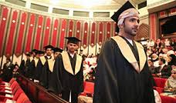

Designing a course is designing an intellectual journey for your students….
Notes:
From student to graduate professional – when you design a course you are designing a student journey...
“In designing a curriculum, whether for a whole degree programme or for a particular unit, you are planning an intellectual 'journey' for your students - a series of experiences that will result in them learning what you intend them to learn”
to design social infrastructures that foster learning
(Wenger 1998, p.225)

Slide 49
Graduate Attributes
‘Graduate attributes are the qualities, skills and understandings a university community agrees its students should develop during their time with the institution … include but go beyond the disciplinary expertise or technical knowledge … qualities that prepare graduates as agents of social good in an unknown future’ (Bowden et al 2000 in Hunt & Chalmers, 2013)

Slide 50
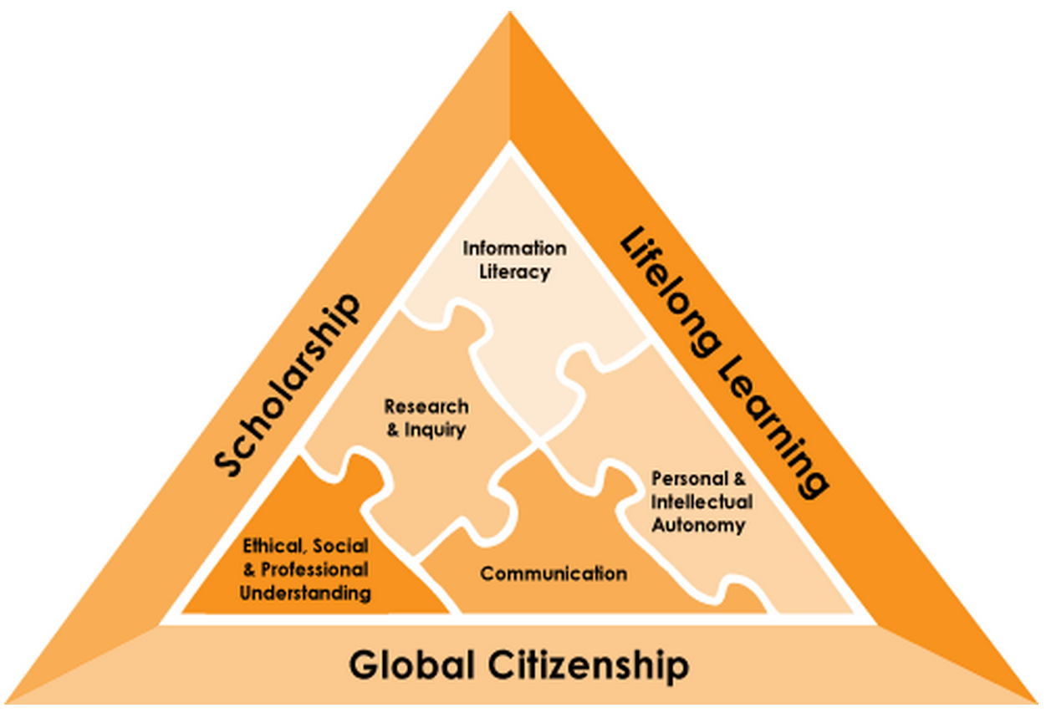
http://www.itl.usyd.edu.au/projects/nationalgap/resources/gamap/map.cfm

Slide 51
Graduate Attributes
Hunt & Chalmers provides some examples on how to engage with employability.
Research and inquiry
Information literacy
Personal and intellectual autonomy
Research and inquiry
Information literacy
Personal and intellectual autonomy
Ethical, social and professional understanding
Communication
Notes:
Compare and contrast different perspectives theories/beliefs
Undertake a research process using key words
Assess their own work using reflective practice
Completing the Universities’ ethics processes
Engage in a range of presentation skills

Slide 52
Graduate Attributes?
In groups spend ten minutes discussing examples you can use to address these questions and then we will share these examples of good practice.
  What are the skills your students will need and how do you ensure they have these skills?
  How can you go about making sure that your students are in thee best possible position to obtain a graduate job?
  What does the competition look like? What are other Universities doing?
  How do you improve your own knowledge of graduate employability within your sector?
  What personal experience have you got to draw on?
  Who should you work with on this?

Slide 53
Misconceptions of Graduate Attribute
Five common misunderstandings regarding the use of Graduate Attributes:
They “are viewed as discrete or atomic entities” that stand alone and so they can be acquired and transferred as single entities.
They are learned quickly as a “one-off event” and finished.
They are acquired by individuals and the learning is located within individuals.
They can be easily recognised and therefore measured.
They can be easily described.
Hager, P. (2006). Nature and development of generic attributes. In P. Hager & S. Holland (Eds.). Graduate attributes, learning and employability. Melbourne: Springer.

Slide 54
Conceptions of Graduate Attributes
A precursory conception
  assumes that students already possess the required generic attributes and there is no relationship between what the teachers do (or perceive they should do) and how these attributes are developed. Discipline knowledge is perceived to be separate from generic attributes.
A complementary conception
  assumes that generic attributes are an outcome of a university education but they are separate and secondary to the acquisition of disciplinary knowledge.
A translation conception
  assumes that generic attributes assist the graduate to use or apply discipline knowledge and translate in in unfamiliar situations.
An enabling conception of GAs
  assumes a complex relation of abilities and aptitudes that enable scholarly learning and the creation of new knowledge.
Barrie, S. C. (2006). What do we mean by the generic attributes of graduates? Higher Education, 51, 2, 215-241

Slide 55
‘Studies have shown that graduating students frequently fail to recognise and identify their development of graduate attributes … this can influence their transition to employment and postgraduate research … important for university teachers … to explicitly signpost the teaching and learning of these skills and attributes’ (Chalmers & Partridge, 2013: 59 in Hunt & Chalmers, 2013)

Slide 56
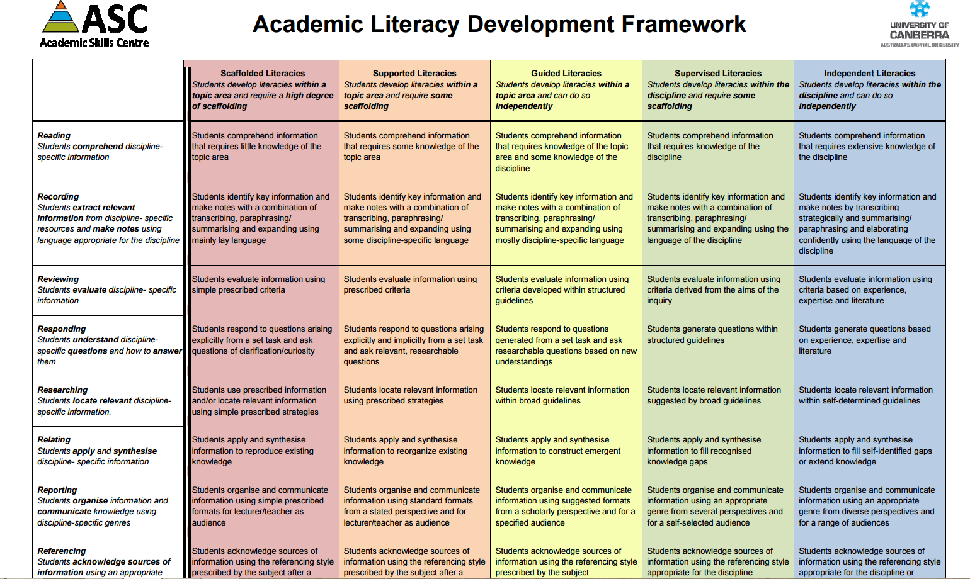
CPIT Example

Slide 57
Resources to support
Hunt, L. & Chalmers, D. (Eds) (2013) University teaching in focus: a learning-centred approach
  Chapters 4, 6 & 7
Fry, H., Ketteridge, S. & Marshall, S. (Eds) (2015) A handbook for teaching & learning in higher education: enhancing academic practice, 4th ed.
  Chapter 6
AUTC Learning Designs - http://www.learningdesigns.uow.edu.au/
Bennett, S., Agostinho, S., Lockyer, L. (2015) Technology Tools to Support Learning Design: Implications Derived from an investigation of University Teachers Design Practices, Computers & Education [Article linked from Moodle]

Slide 58
Assessment Literacy

Slide 60
Integrated assessment
Programme focused assessment - http://www.pass.brad.ac.uk/short-guide.pdf

Slide 61
Key CU challenges and drivers
2 week turnaround of coursework
High % of International students
Semesterisation of courses
The need to develop assessment for learning
Developing a coherent student course experience

Slide 62

Notes:
What are the key issues to come out of this

Slide 63
Key Assessment issues
Theory separated out from practice
Not understanding standards (both staff and students)
Expectations of staff and students
Silo approach to assessment based on modules
  Bunching of assessments
  No linkage
Too much diversity
Notes:
Students not seeing the relevance of theory
Standards – not a common understanding of standards by staff and students
Expectations not understood by students
Assessment
Assessment innovations at the individual module level often fail to address assessment problems at the programme-level, some of which, such as too much summative assessment and not enough formative assessment, are a direct consequence of module-focused course design and innovation.

Slide 64
Assessment Patterns that Fail
Too much summative assessment
Trivial assignments make low intellectual demands
Feedback that does not feed forward
Too much variety in forms of assessment
Over-reliance on documentation to clarify goals and standards
Source: TESTA (www.testa.ac.uk)
Notes:
Use the testa sheet on the range of assessments in programmes.

Slide 65
Assessment Standards: A manifesto for change…
Tenet 1: Assessment for learning
Tenet 2: Ensuring assessment is fit for purpose
Tenet 3: Recognize that assessment lacks precision
Tenet 4: Constructing standards in communities
Tenet 5: Integrating assessment literacy into course design
Tenet 6: Ensuring professional judgments are reliable

Slide 66
An integrated approach
Take an outcomes based approach to assessment and consider course level outcomes to use to map knowledge, skills and attributes across the course.
Schedule assessments at a Course Level.

Slide 67
An integrated approach
Dealing with the assessment diversity – ‘routes’ through the course.
Increasing the use and effectiveness of feedback.
5. Integrated assignments

